Slide 1

HOSPITAL MANAGEMENT
By
Harshita Anantharaju
Vineet Sheth
Alcina Travis
Under the guidance of Professor Paul Dantzig

Slide 2

Contents
Introduction
Entity Relationship Diagram
Show Table
Physician Table Records
Patient Table Records
Nurse Table Records
SQL Query Outputs

Slide 3
Introduction
Putting more care into healthcare database management.
Having such a large amount of data makes it difficult to find a specific record; therefore, a database allows us to find a specific record in seconds.
Our hospital database system is now used for a wide range of purposes such as :
Patient information such as Name, SSN, Address, Phone, Insurance ID.
Medication details such as the Code, Name, Brand, and Description.
Nurse information such as EmployeeID, Name, Position, Registered, SSN.
Physician Information and department.
Appointment details such as AppointmentID, Patient, Physician, Nurse, Start and End date, Examination room.
With the help of joins, this database can display any of the patient, physician, nurse, medication, and allocation details.

Slide 4
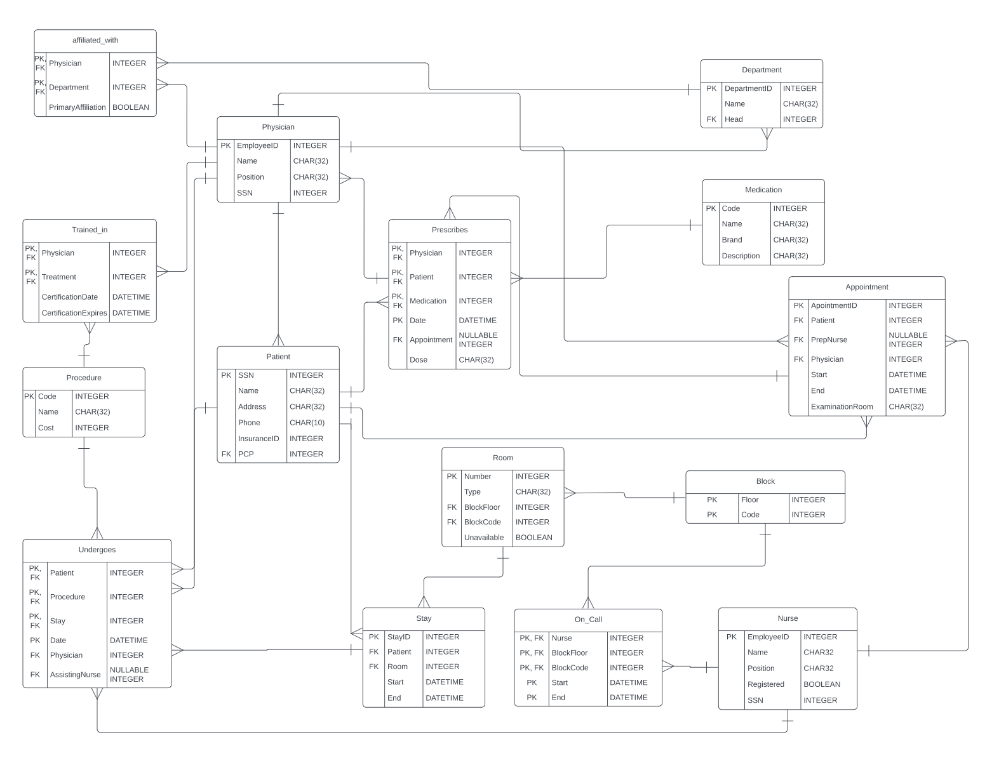
Entity Relationship Diagram

Slide 5
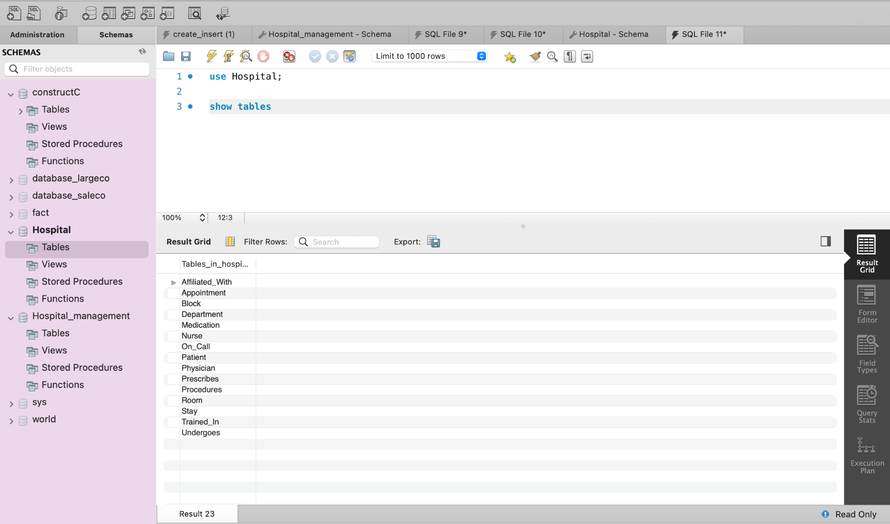
Show Table

Slide 6
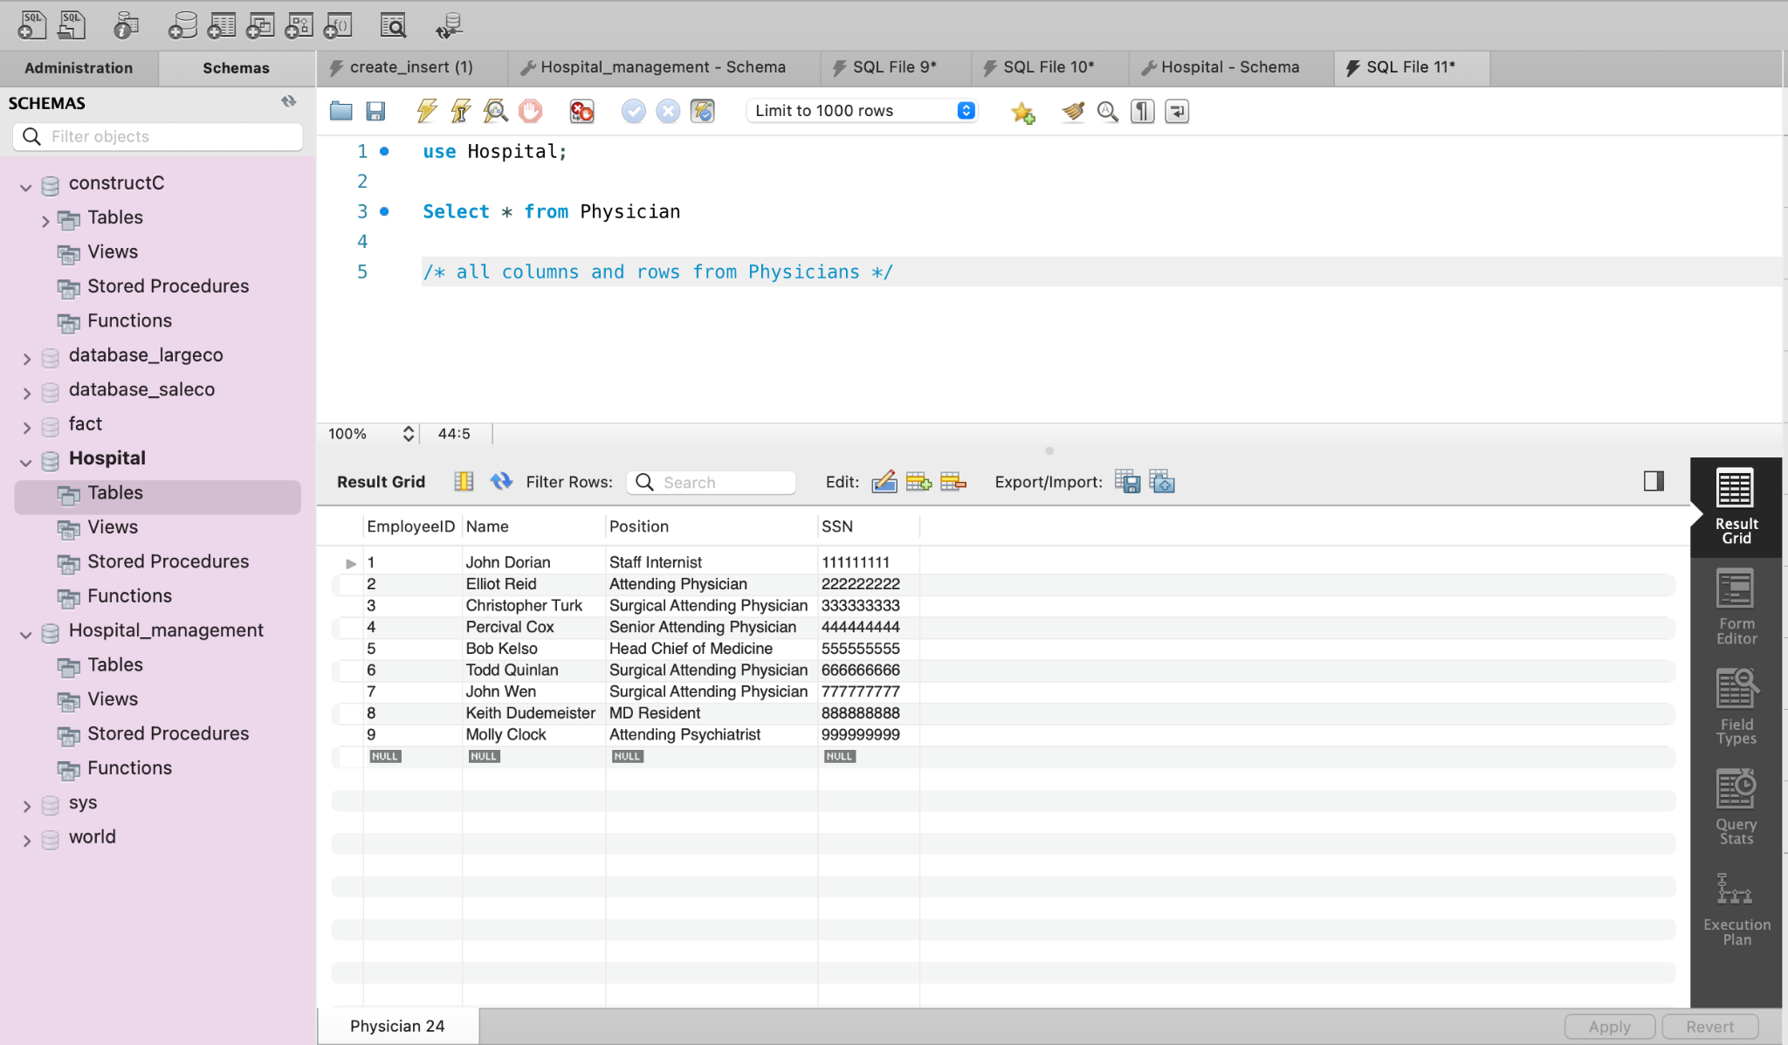
Physician Table Records

Slide 7
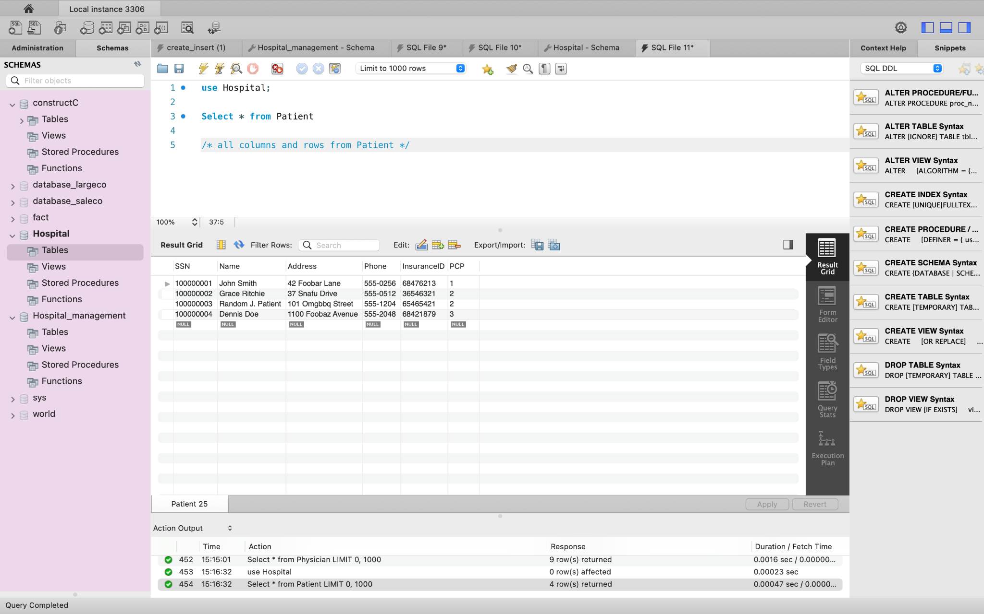
Patient Table Records

Slide 8
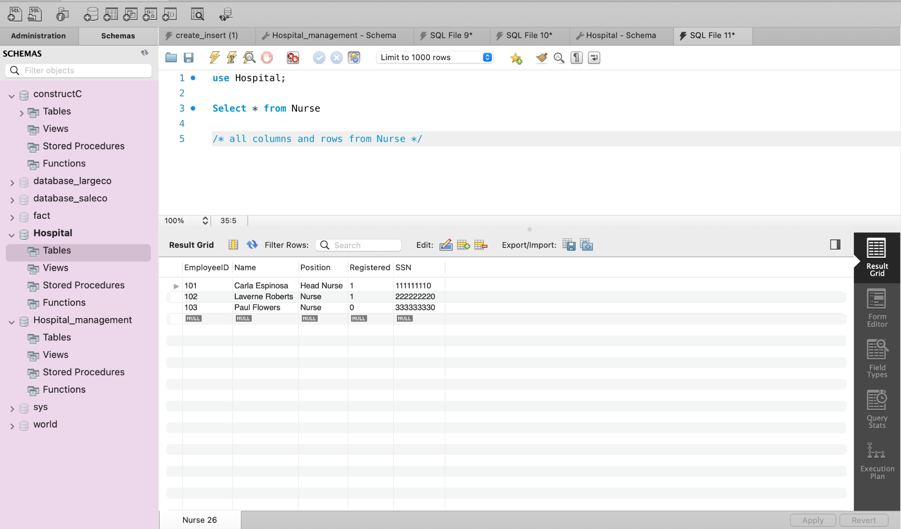
Nurse Table Records

Slide 9
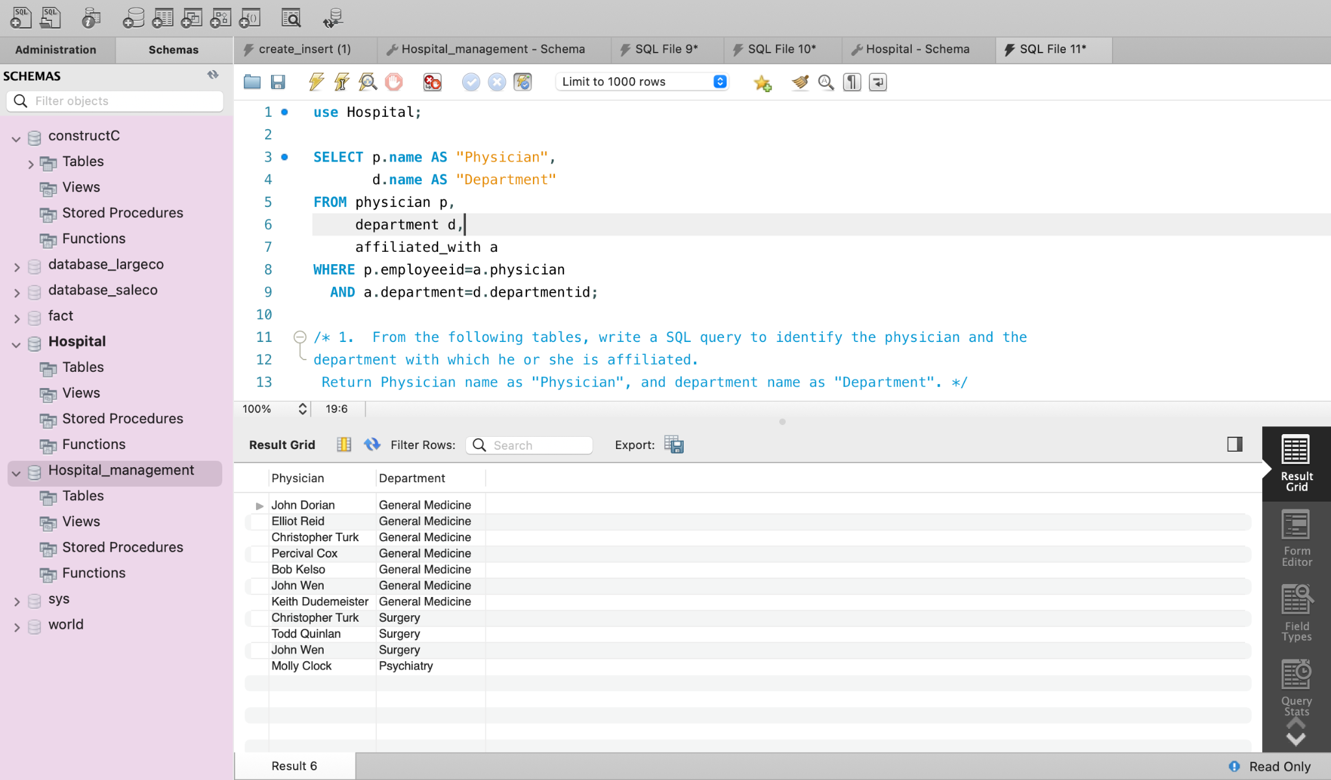
SQL Query Output
Query shows name of the physicians and its affiliated department.

Slide 10
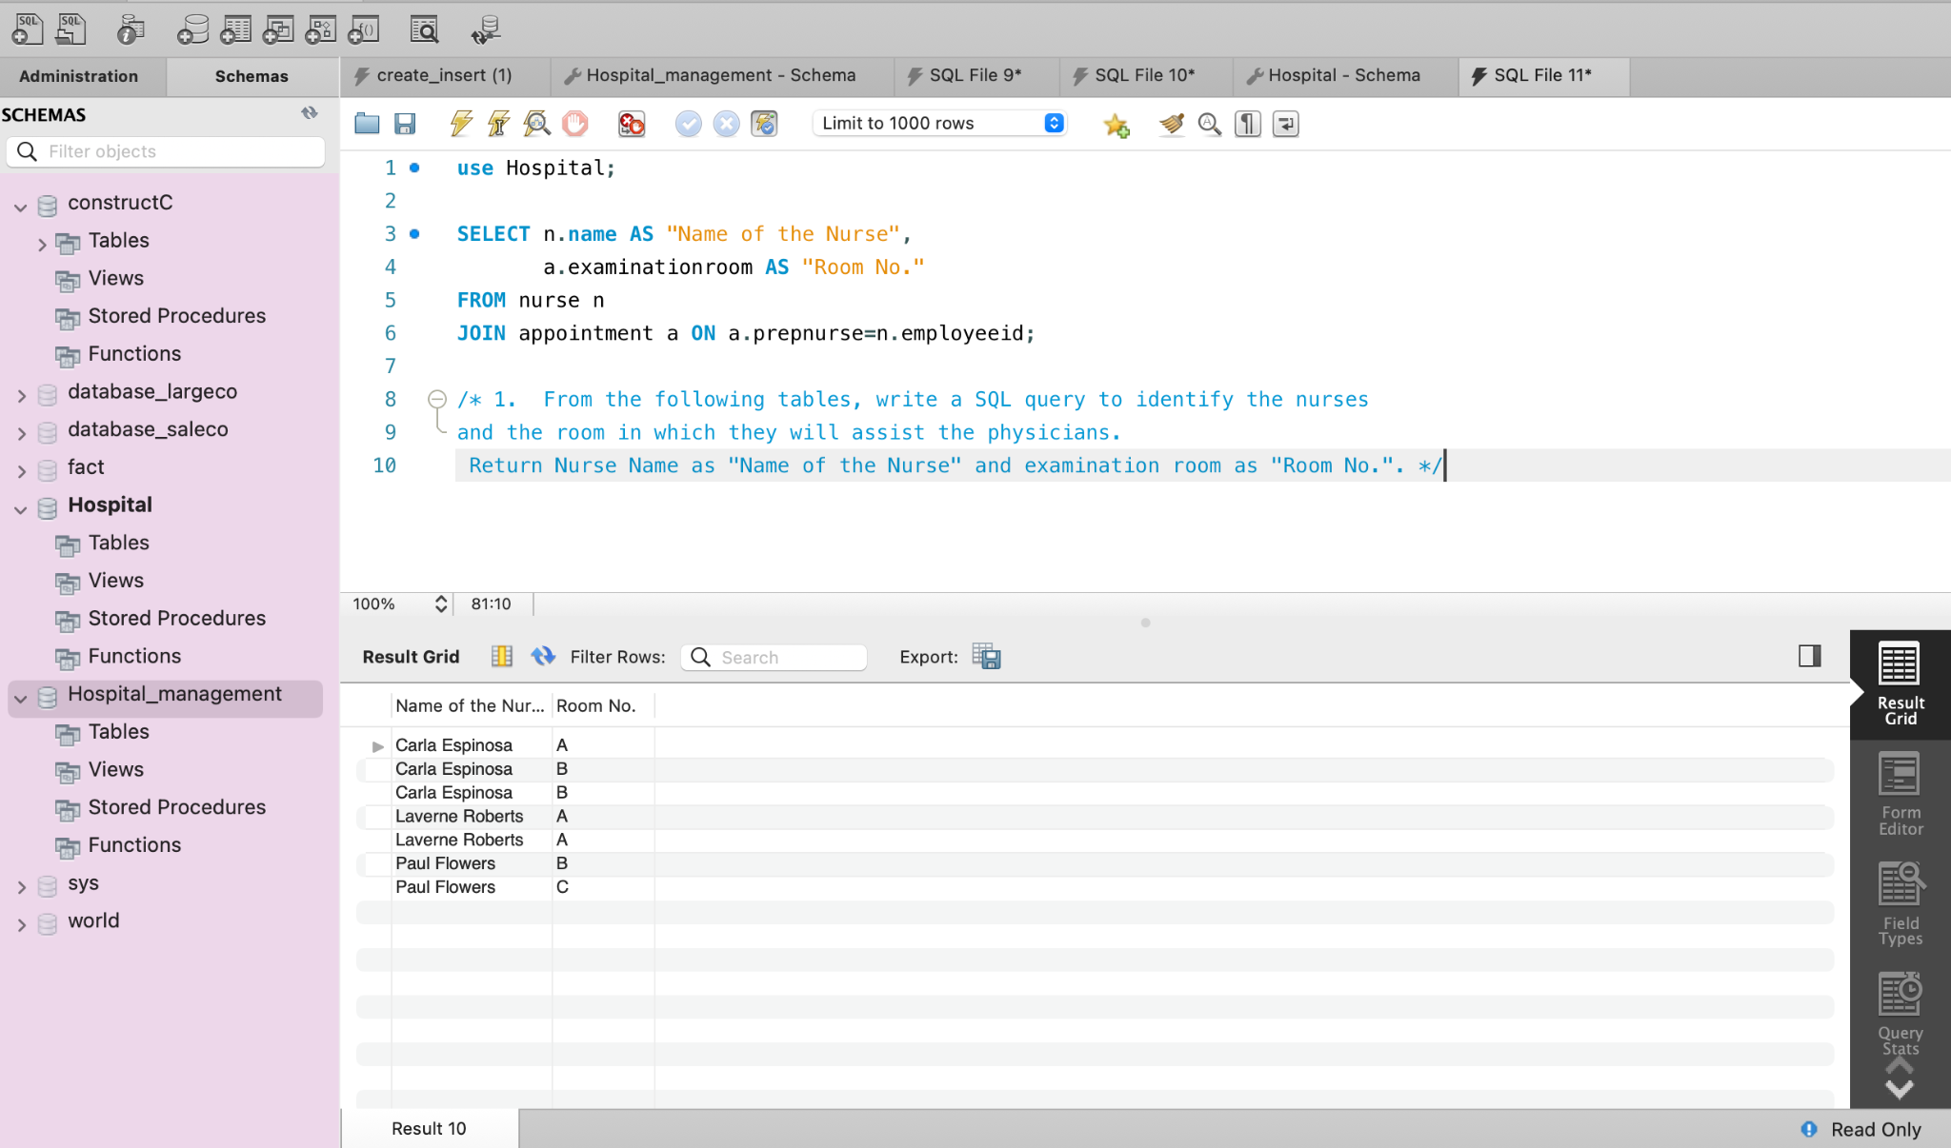
SQL Query Output
Query shows name of the nurses and the room in which they will assist the physicians.

Slide 11
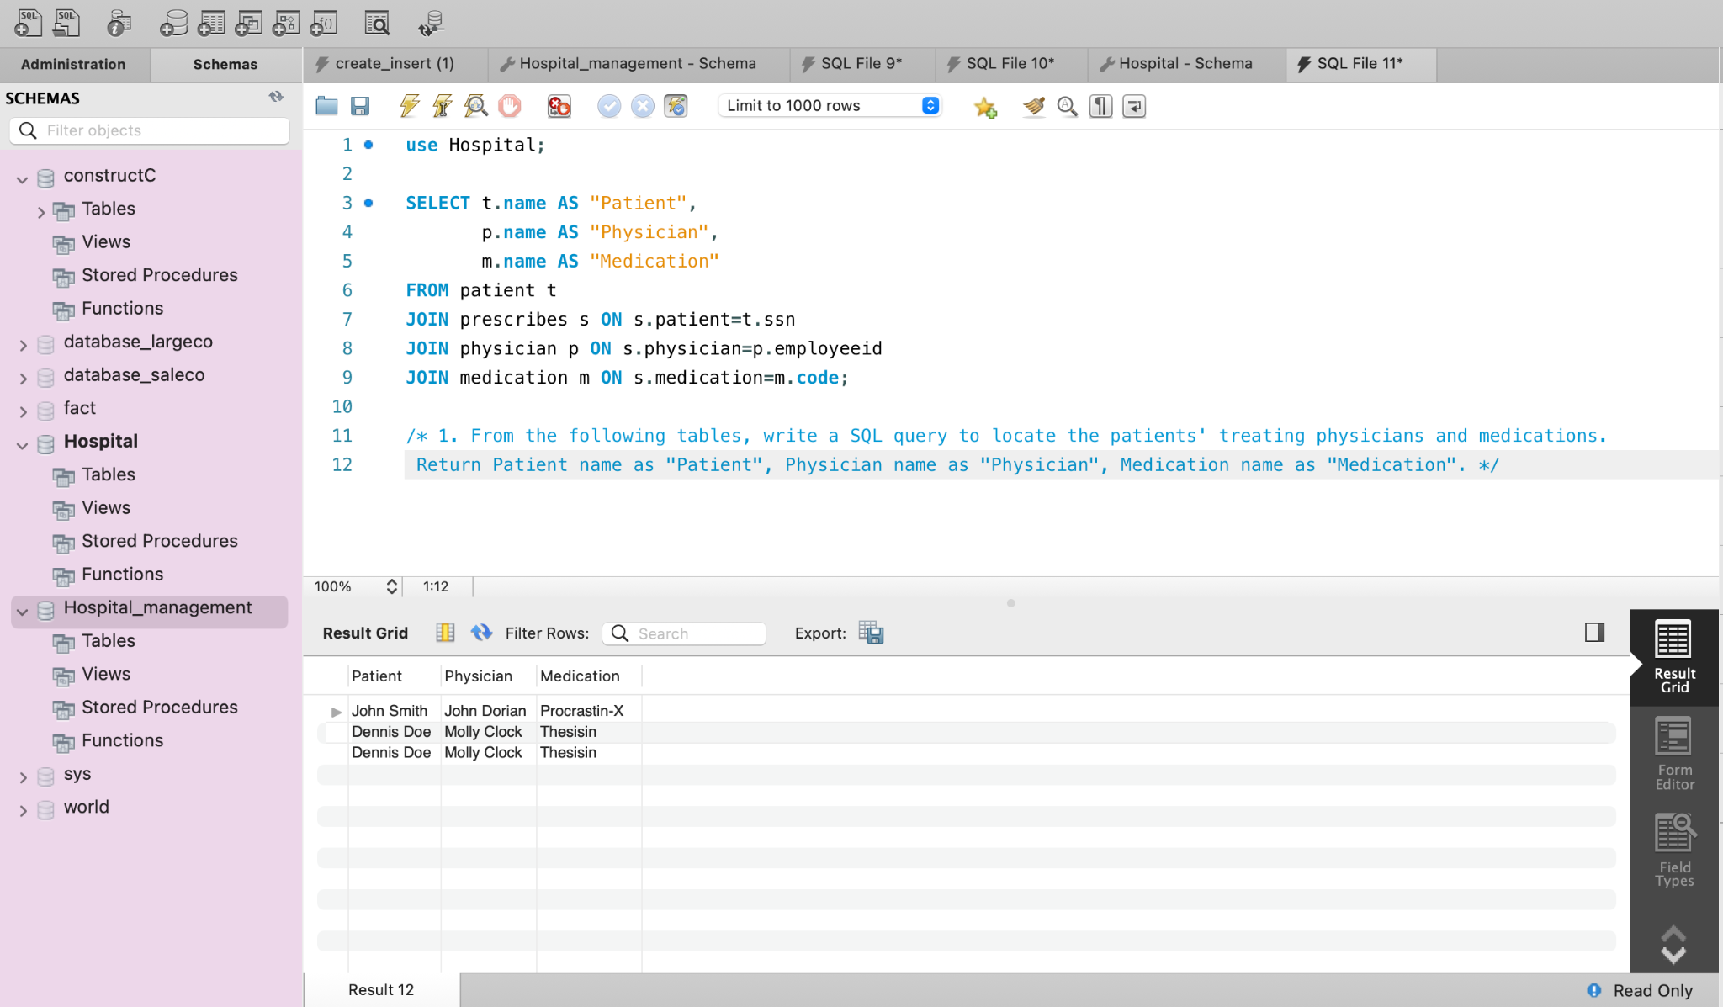
SQL Query Output
Query shows name of the patient, physician allocated and medication to be done.

Slide 12
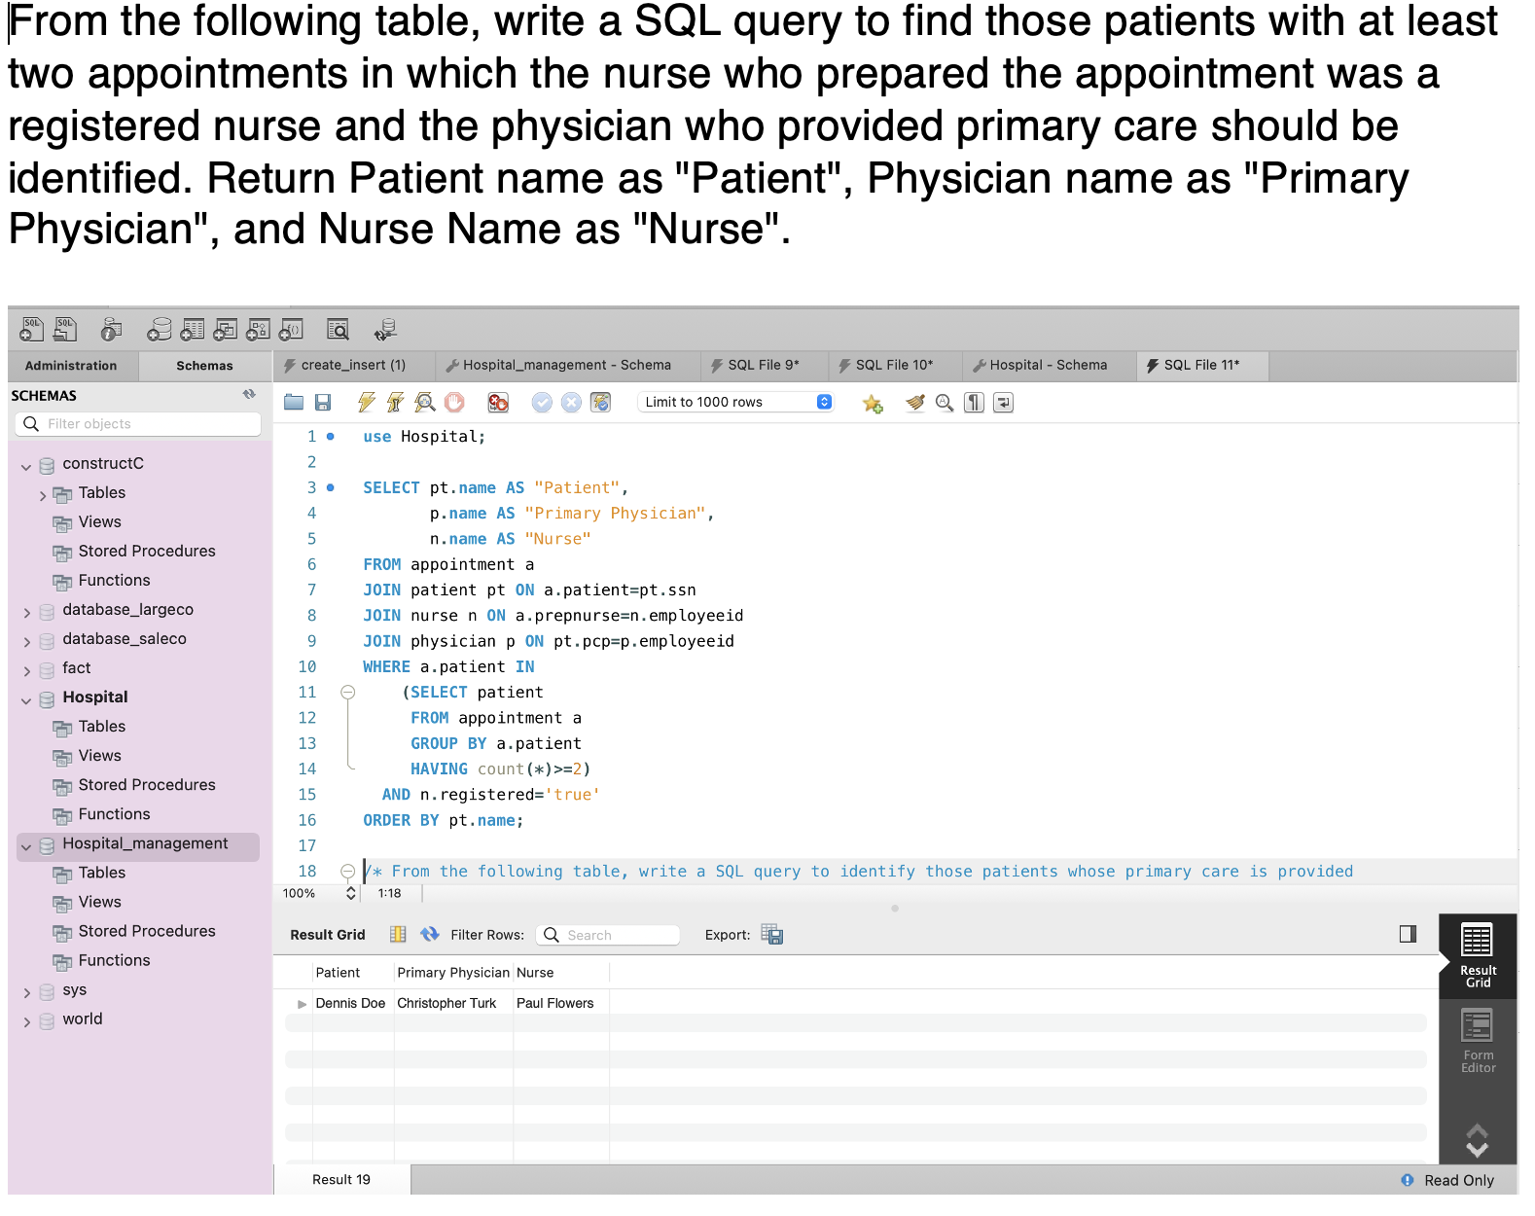
SQL Query Output
Query shows number of patients provided with primary care physician along with nurse name.

Slide 13
References & Data related questions
The dataset was acquired from Kaggle.com
There are 9 entries for Physician, 3 inputs for Department, 9 inputs for Affiliated_with, 7 for Procedures, 4 Patients, 9 Appointments, 5 Medications, 3 Prescribes, 12 Block, 36 Rooms, 6 On_Call, 3 Stay, 6 Undergoes and 15 trained_In.
The data also contained lot of null values and miss information that created errors. Hence conducted a cleanup over the data for more efficiency.

Slide 14
THANK YOU!
Special thanks to professor Paul Dantzig for guiding & mentoring through the project.

